Slide 1
Authoring OGC Standards
The 124th OGC Member Meeting
Gobe & Ronald
28 September 2022

Slide 2
Part 2

Slide 3
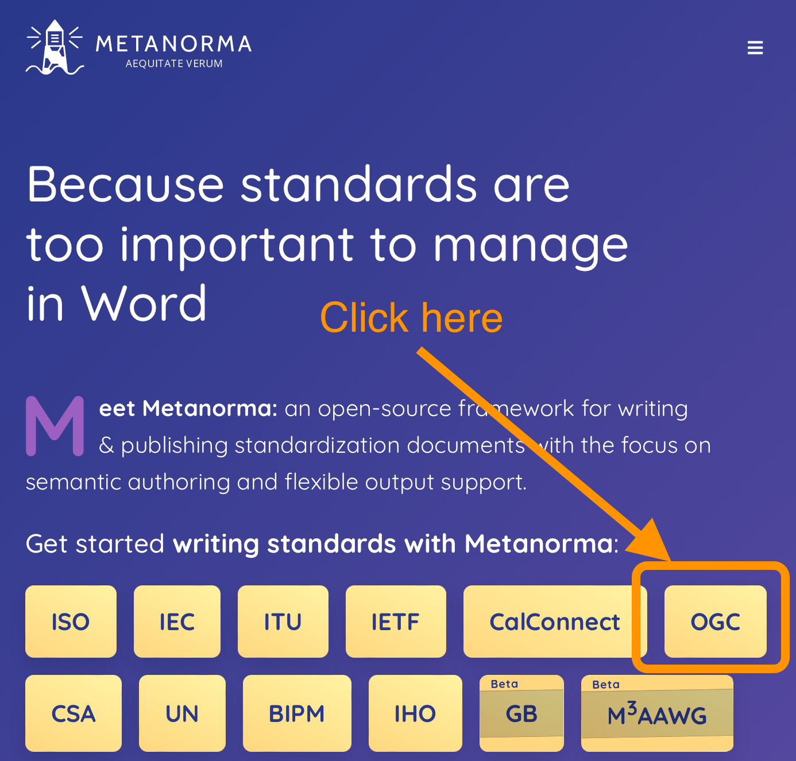
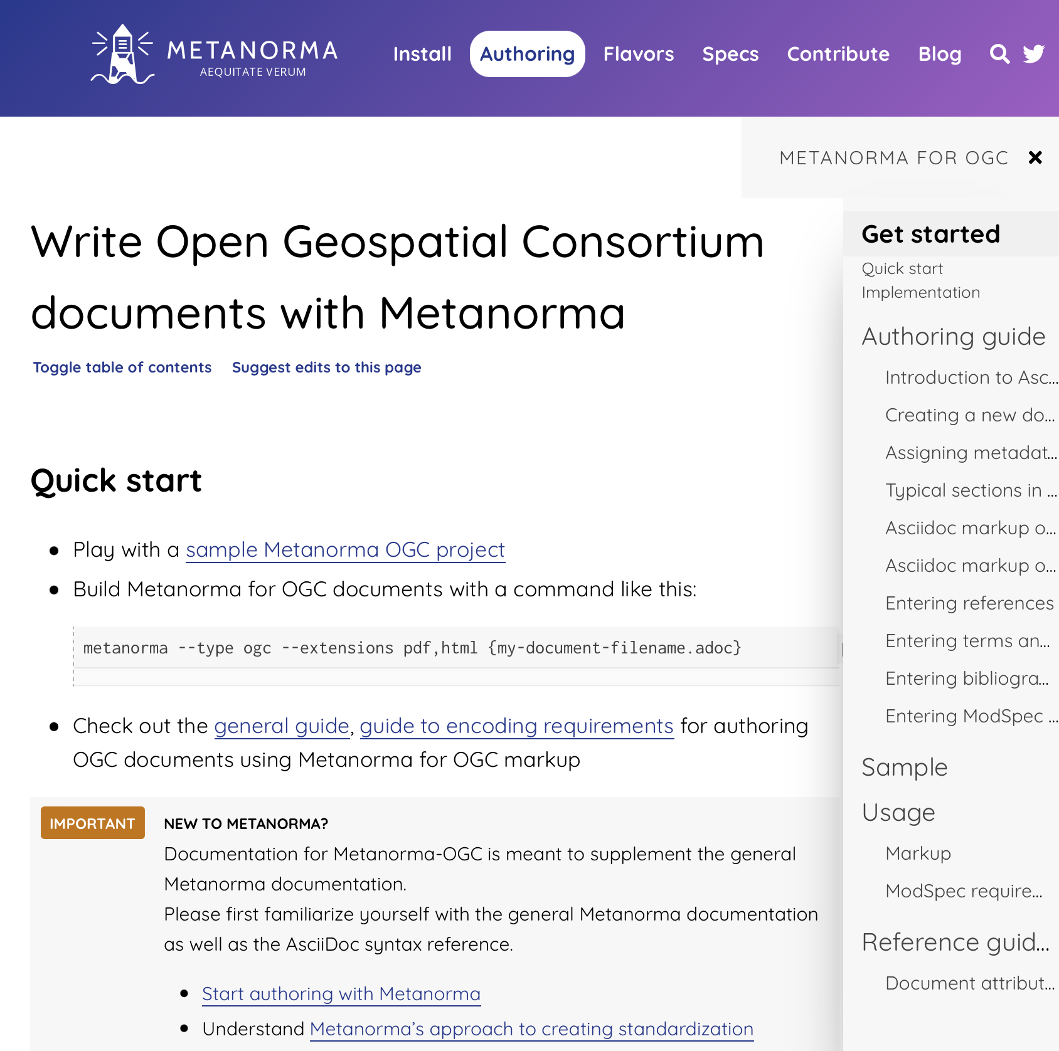
Where to find information?
Authoring
guide
Markup and ModSpec
Document attributes

Slide 4
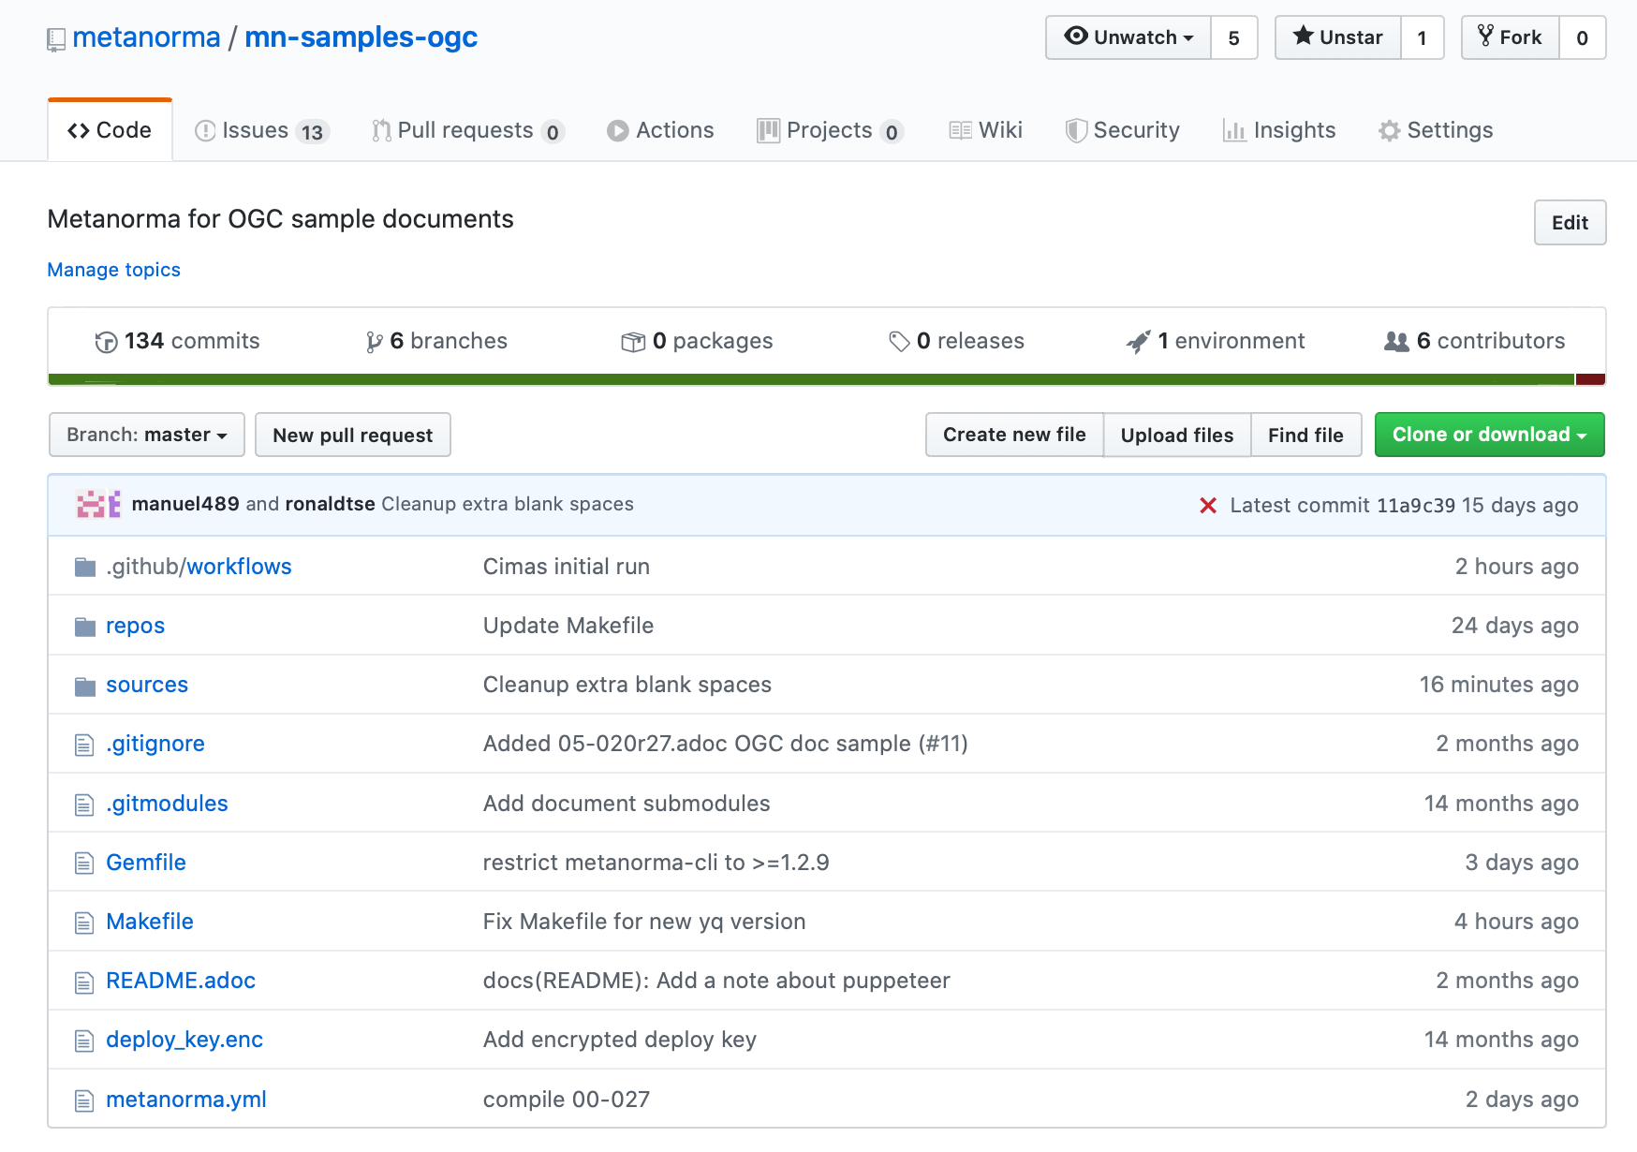
Repo for OGC document samples
OGC document samples available here:
https://github.com/metanorma/mn-samples-ogc

Slide 5
Many OGC document samples now available
Standard, subtype implementation: 17-069r3
Abstract specification topic: 15-104r5
Best practice, subtype general: 16-114r3, 15-120r5
Discussion paper: 19-004
Whitepaper: 16-131r2
Release notes: 18-016r1
Community standard: 18-053r2
Engineering report: 18-046
Reference model: 08-062r7
User guide: 16-080
Policy: 05-020r27
Profile: 10-100r3
Tech corrigendum: 14-065r2
Standard, with suite:
Test suite: 00-027
Community practice 18-097r3

Slide 6
Font management in Metanorma
OGC uses the Lato font, an open-source font that is not installed by default on major OSes, for PDF
Available on Adobe Fonts and Google Fonts
Metanorma helps you install all necessary fonts, as long as you “agree to font terms”!
`metanorma mydoc.adoc --agree-to-terms`

Slide 7
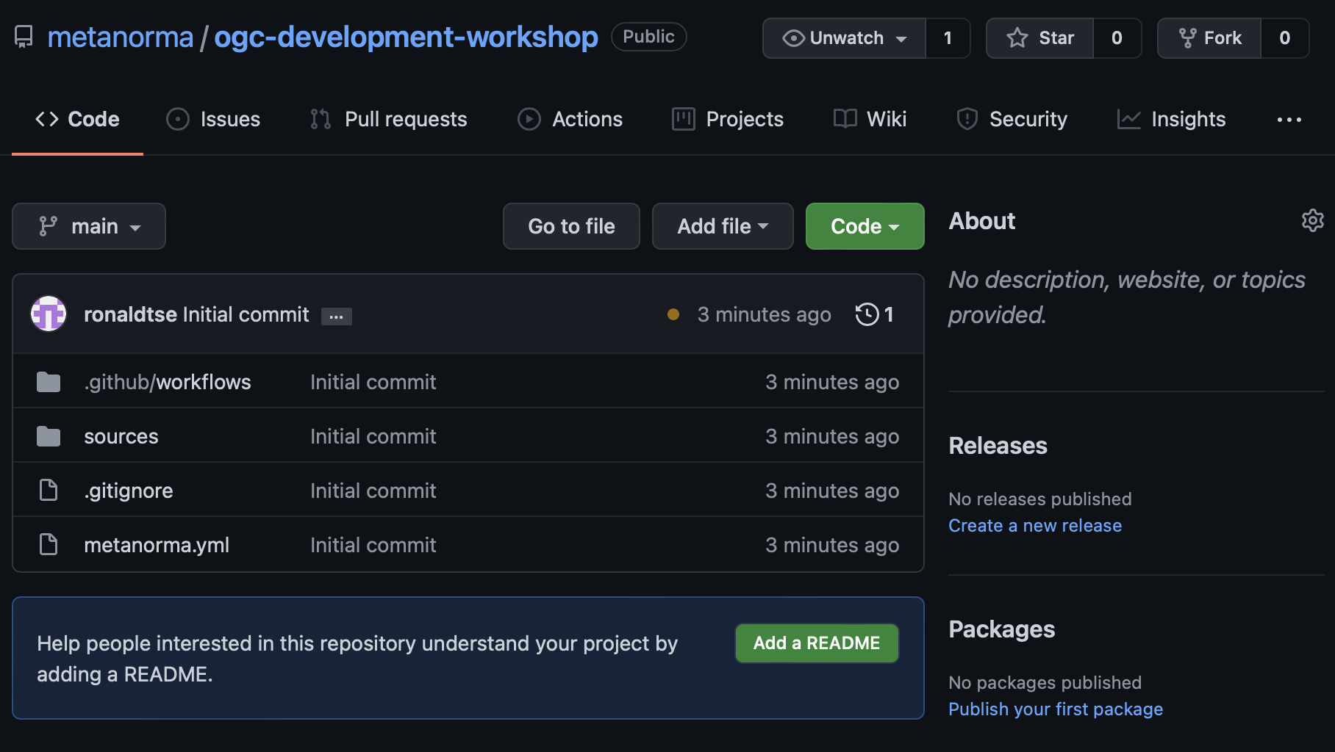
Let’s try compiling a document (based on 18-095r7)!
https://github.com/metanorma/ogc-development-workshop
Docker/Linux (recommended) https://www.metanorma.org/install/docker/
macOS: https://www.metanorma.org/install/macos/
Windows: https://www.metanorma.org/install/windows/

Slide 8
Steps
Local install run:
metanorma site generate --agree-to-terms
Docker on Linux/macOS:
Docker on Windows (cmd) run:
docker run ^
-v %cd%:/metanorma ^
-v %USERPROFILE%\.fontist\fonts:/config/fonts ^
-w /metanorma ^
-it ^
metanorma/mn ^
metanorma site generate --agree-to-terms
docker run \
-v "$(pwd)":/metanorma \
-v "${HOME}/.fontist/fonts":/config/fonts \
-w /metanorma \
metanorma/mn \
metanorma site generate --agree-to-terms

Slide 9
Now that we can compile let’s try updating it
Let’s pretend we want to update this document to satisfy the latest rules.
Terms and definitions should be in Clause 3
Missing submitter organizations
How to fix?
Can we get rid of these warnings?
Metanorma XML Style Warning: (XML Line 000227): Hanging paragraph in clause
Metanorma XML Style Warning: (XML Line 000678): Hanging paragraph in clause
Metanorma XML Style Warning: (XML Line 000794): Hanging paragraph in clause
Metanorma XML Style Warning: (XML Line 001195): Figure should have title
Metanorma XML Style Warning: (XML Line 000091): Table should have title
Metanorma XML Style Warning: (XML Line 001349): Table should have title

Slide 10
Encoding ModSpec
[requirement]
[requirements_class]
[conformance_test]
[abstract_test]
[conformance_class]
[permission]
[recommendation]
Constraints:
Every standard must have at least 1 requirements class
Every requirements class must have at least 1 conformance class
Every requirements class must have at least 1 requirement
Every conformance class must have at least 1 conformance test
Every requirement must have at least 1 conformance test

Slide 11
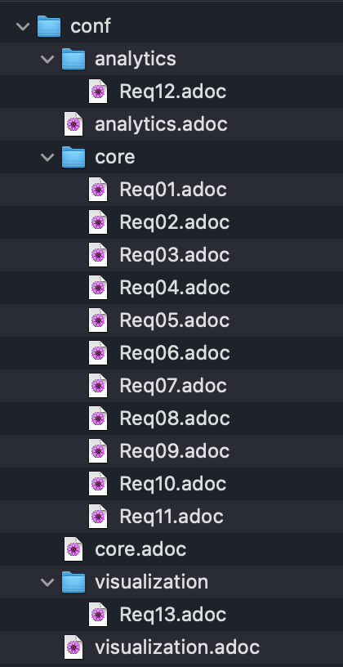
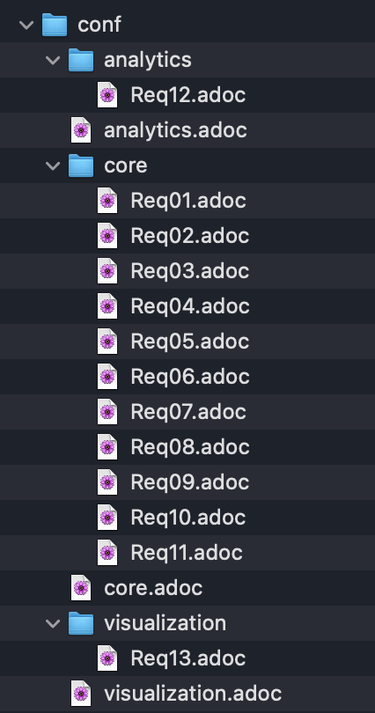
Representing ModSpec
Requirements class
/req/{class}
Conformance class
/conf/{class}
Requirements
/req/{class}/{id}
Conformance tests
/conf/{class}/{id}

Slide 12
Thank you, questions welcome!

